Slide 1
Machine Learning & Deep Learning
Week-22_23
Instructor: Engr. Najam Aziz
National Center for Big Data & Cloud Computing (NCBC), UET Peshawar

Slide 2
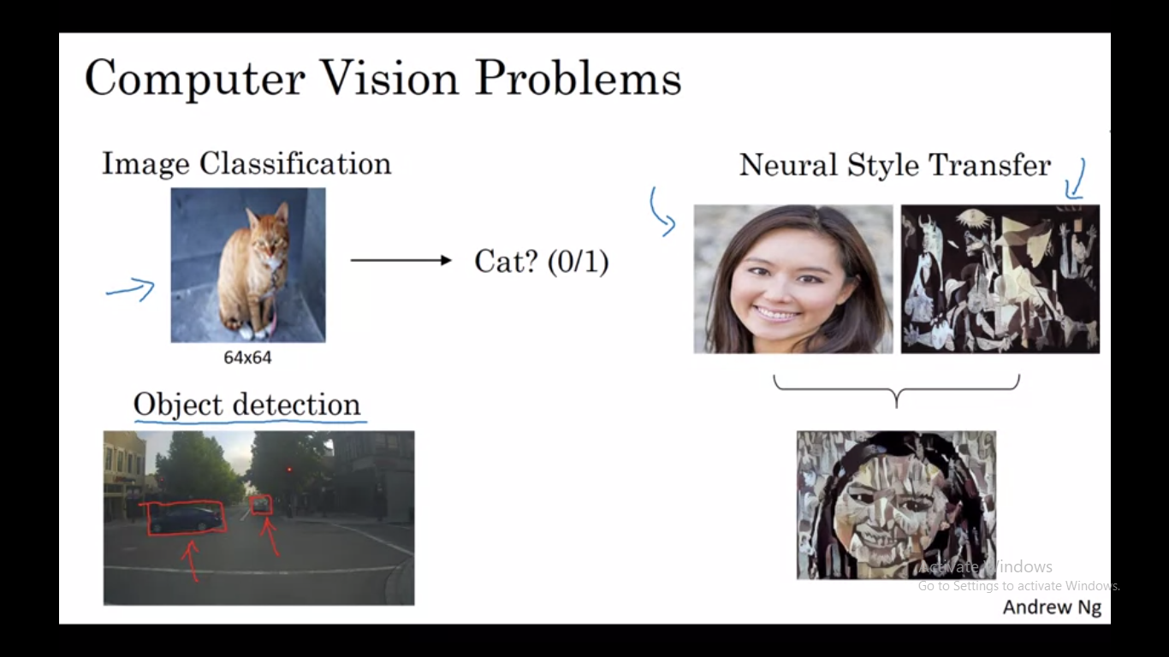

Slide 3
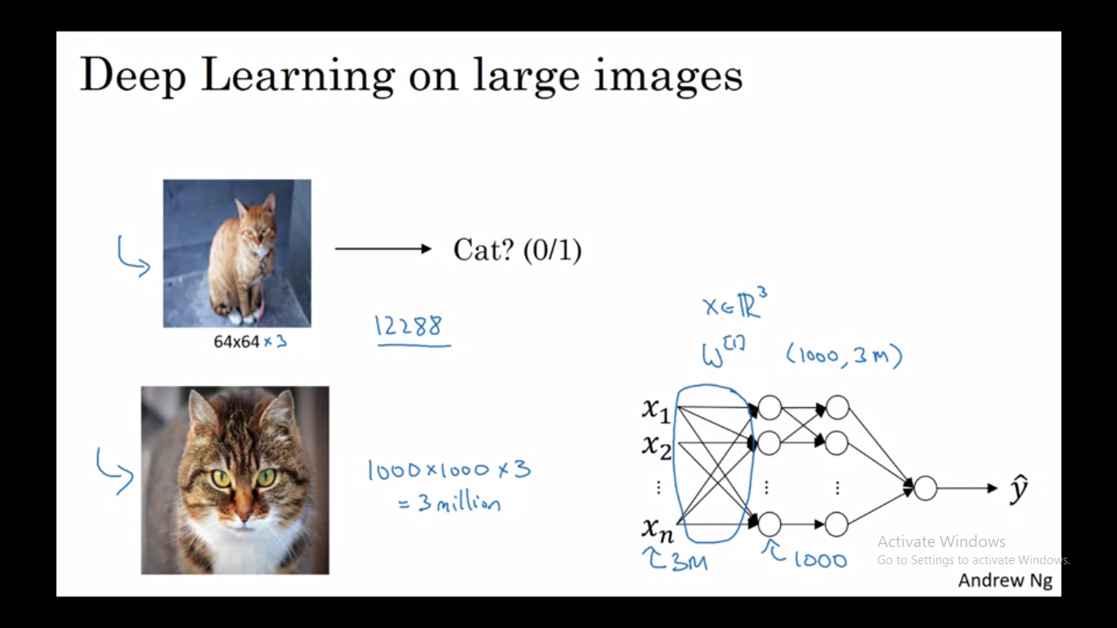

Slide 4
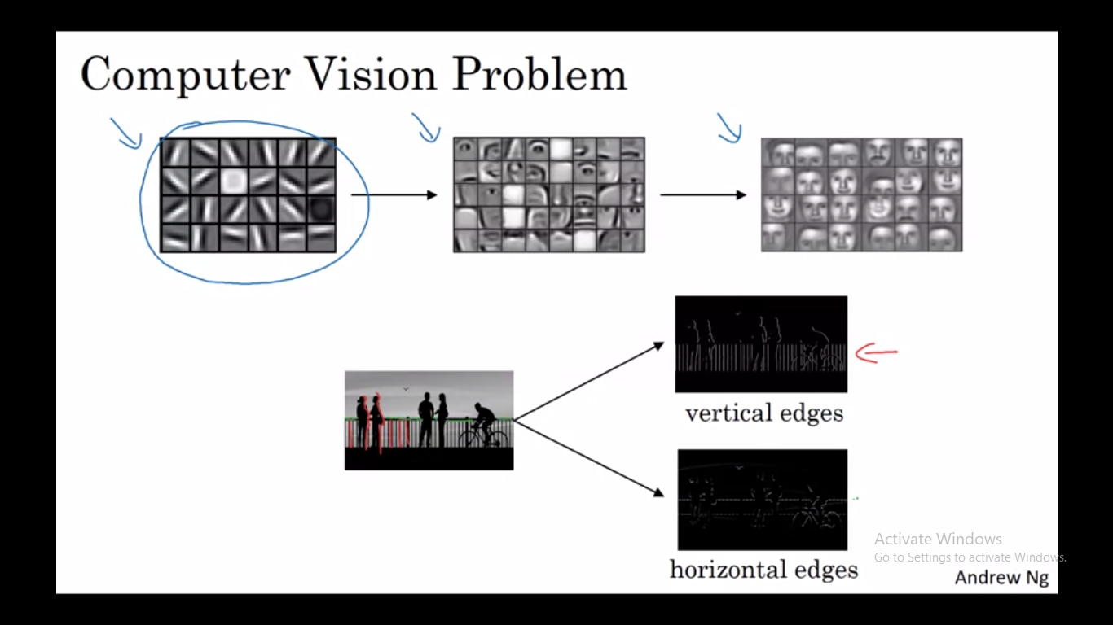

Slide 5
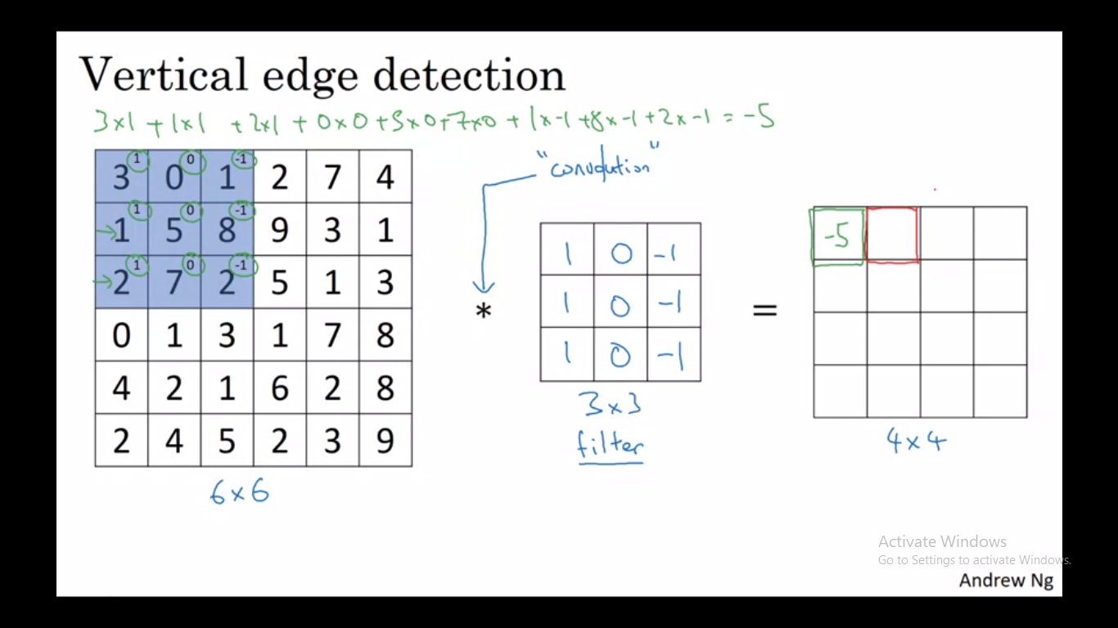

Slide 6
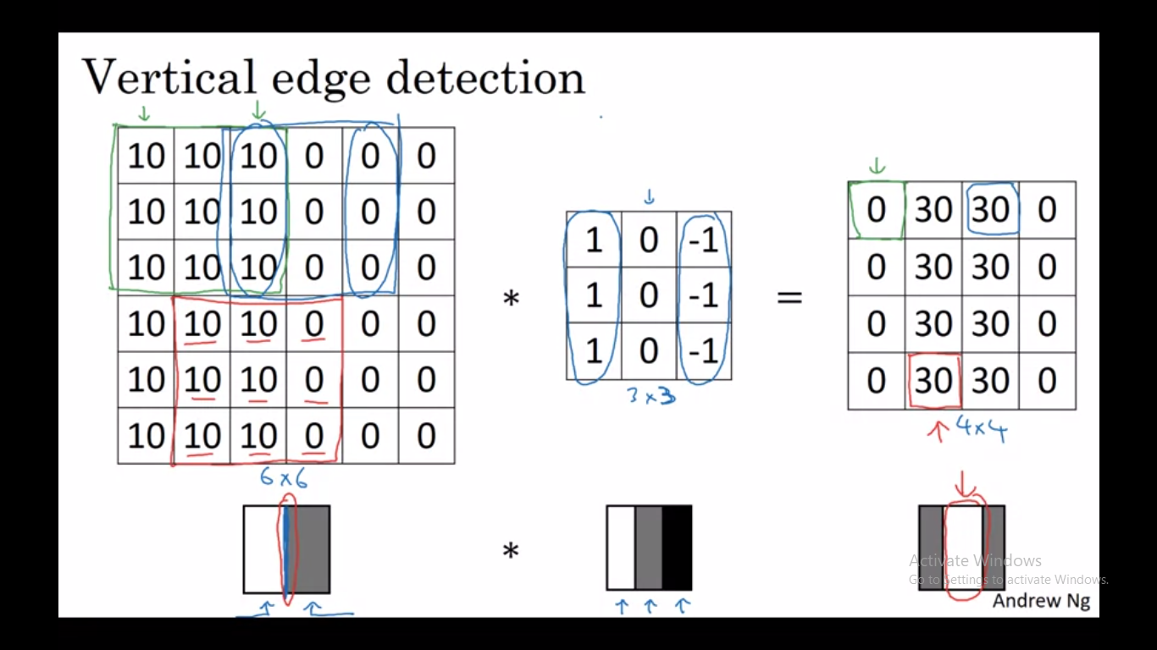

Slide 7
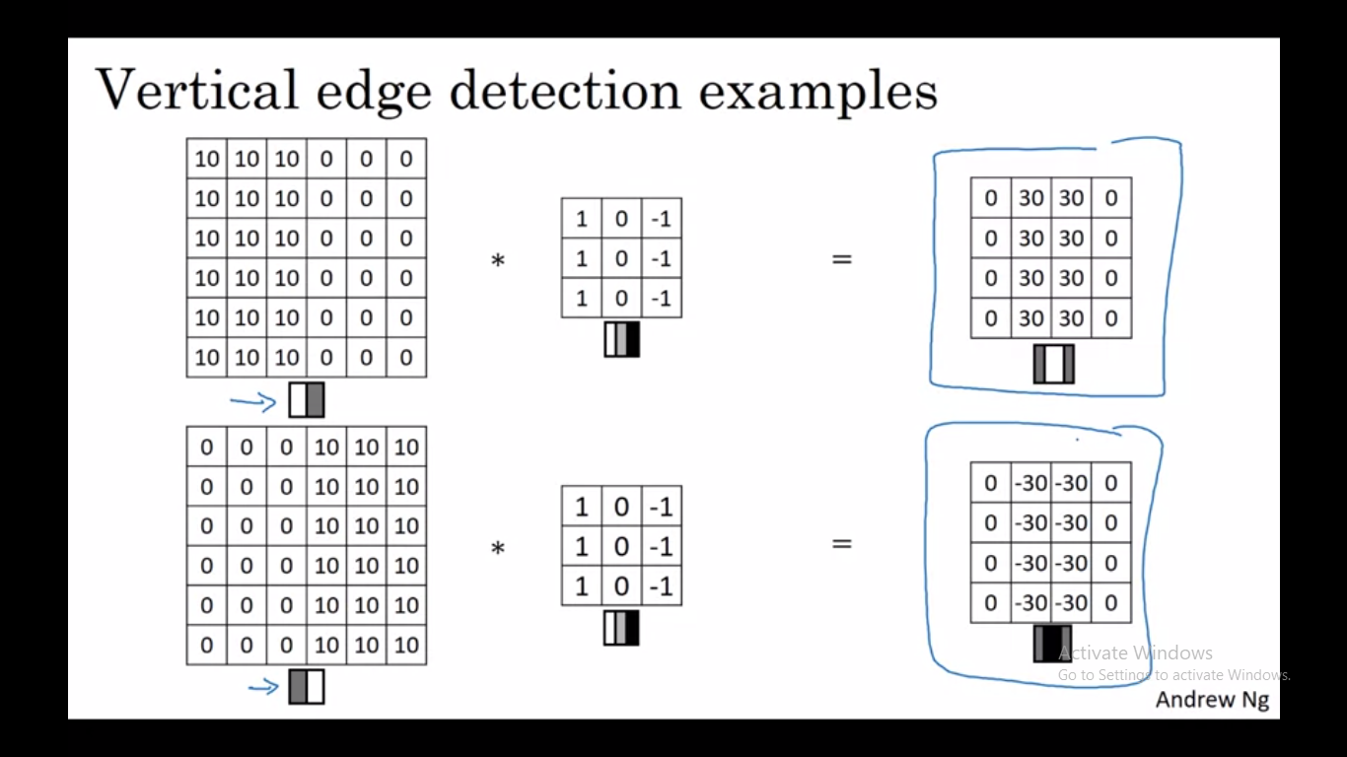

Slide 8
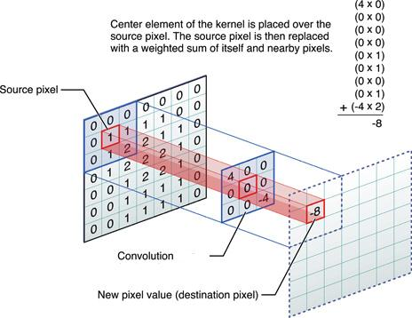

Slide 9
Filters/Kernel
Every layer of filters is there to capture patterns. For example, the first layer of filters captures patterns like edges, corners, dots etc. Subsequent layers combine those patterns to make bigger patterns (like combining edges to make squares, circles, etc.).
Now as we move forward in the layers, the patterns get more complex; hence there are larger combinations of patterns to capture. That's why we increase the filter size in subsequent layers to capture as many combinations as possible.

Slide 10
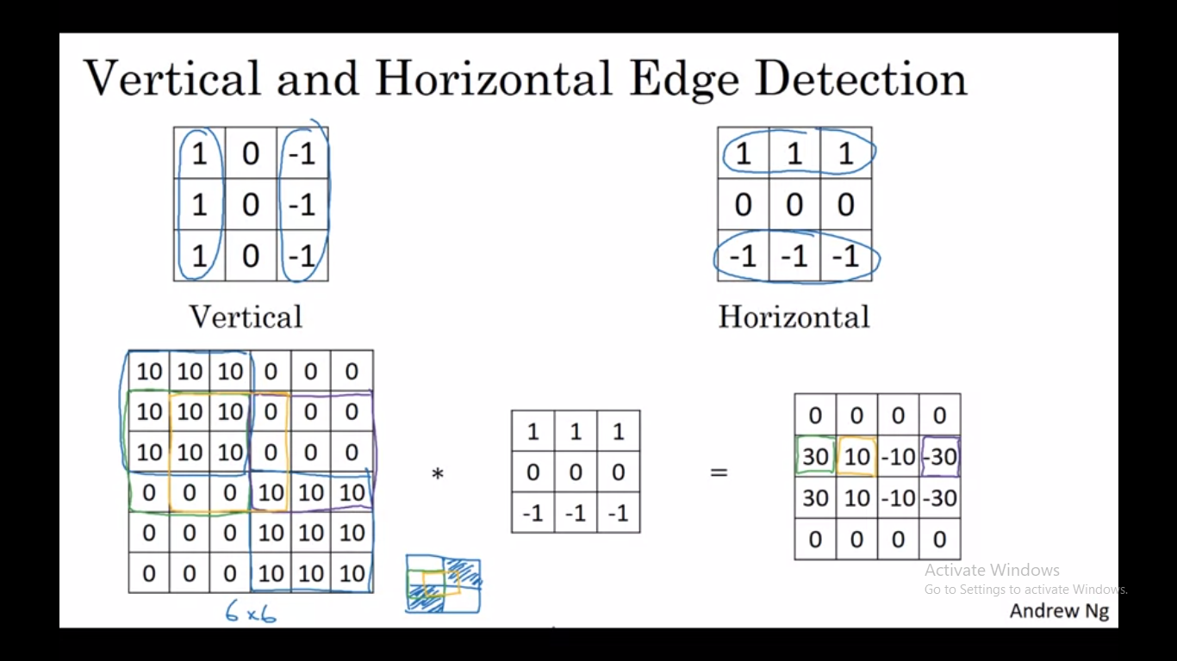

Slide 11
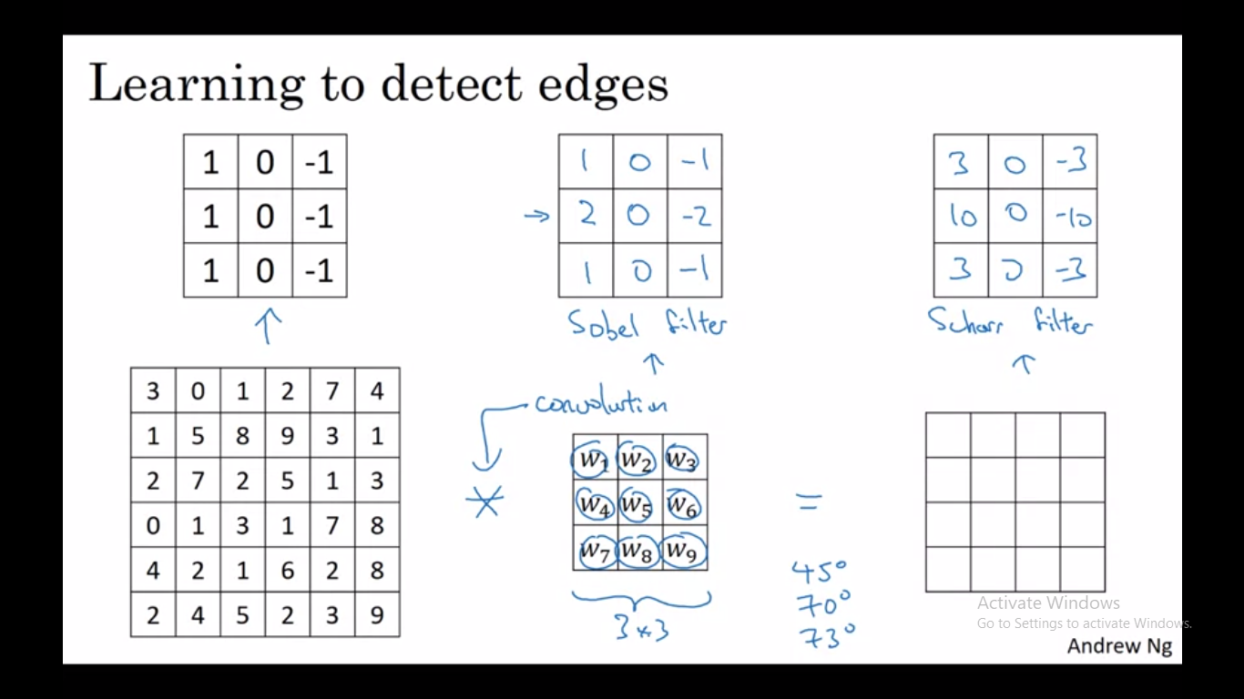

Slide 12
Padding
Downsides of Convolution:
Image shrinks, but sometime we don’t want to shrink it after every convolution or step. Bcoz in a very deep NN, the image will shrink to very small image.
The pixels on the corners or edges use much less in the output than the pixels at center. Which means throwing away lot of information near the edges of an image.
To solve both these problem, we need Padding.
In order to build deep neural network one modification to the basic convolutional operation that we need to really use, is padding. We pad the image before convolutional operation.

Slide 13
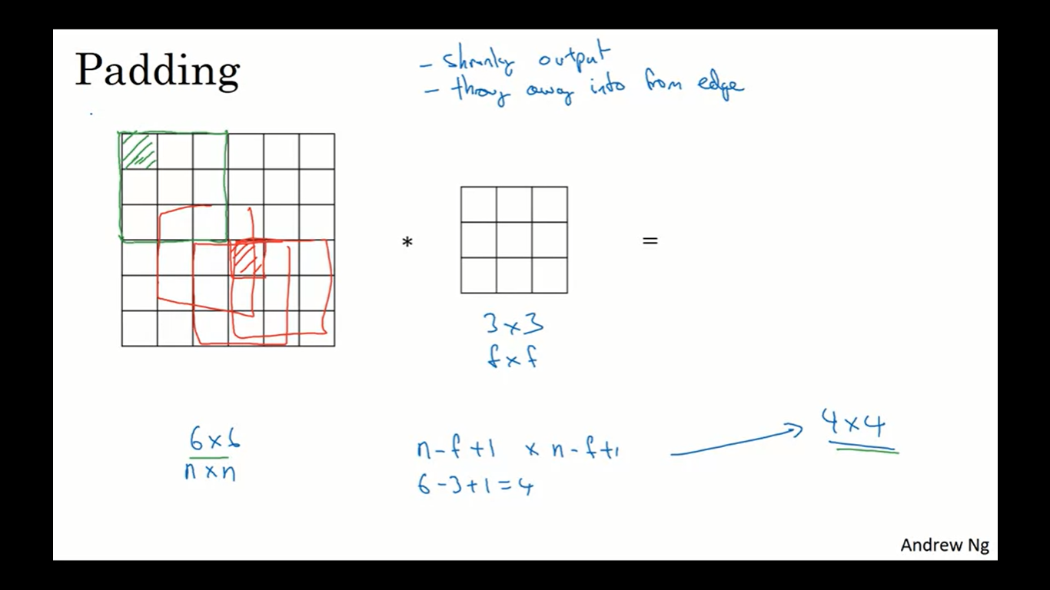
Downside of Convolution

Slide 14
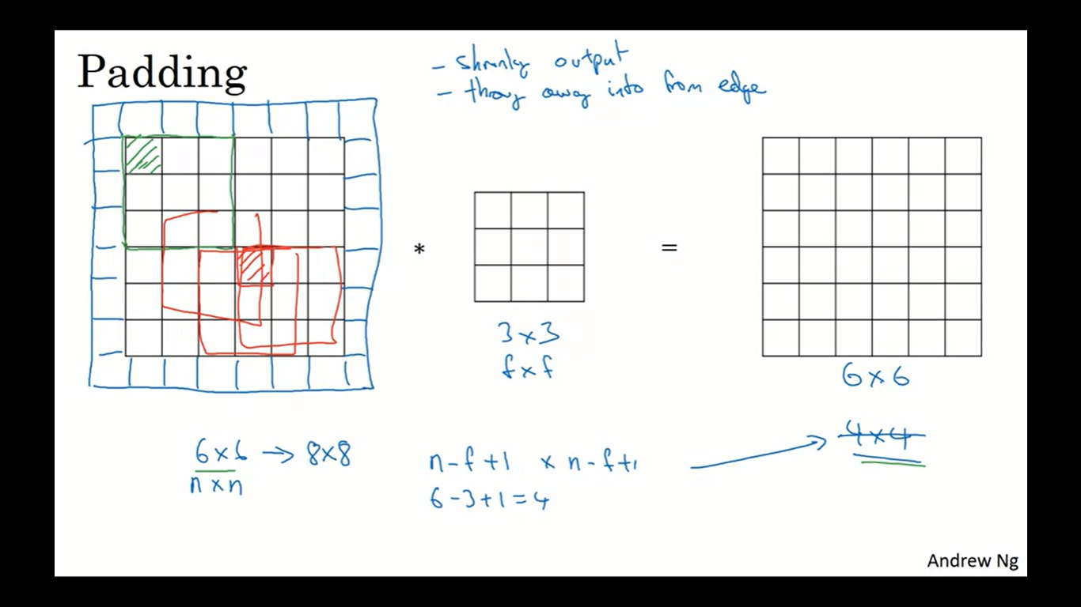

Slide 15
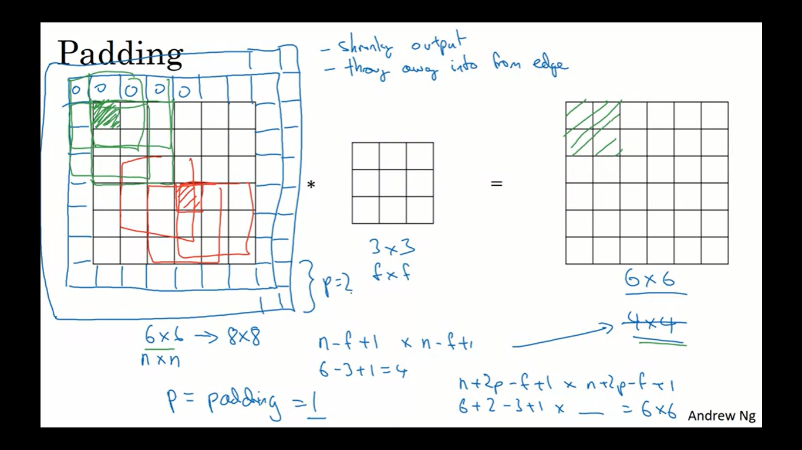

Slide 16
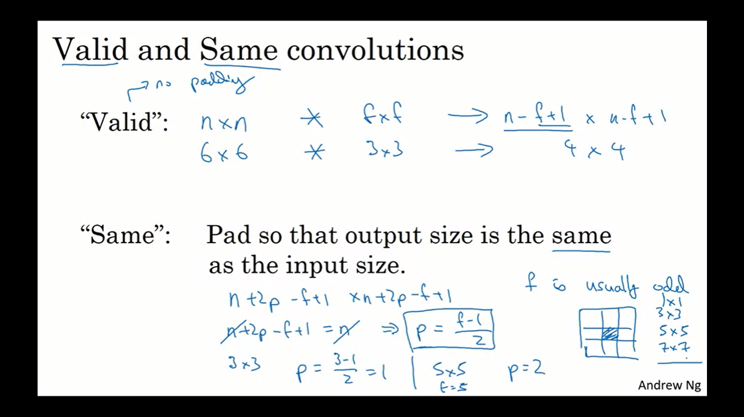

Slide 17
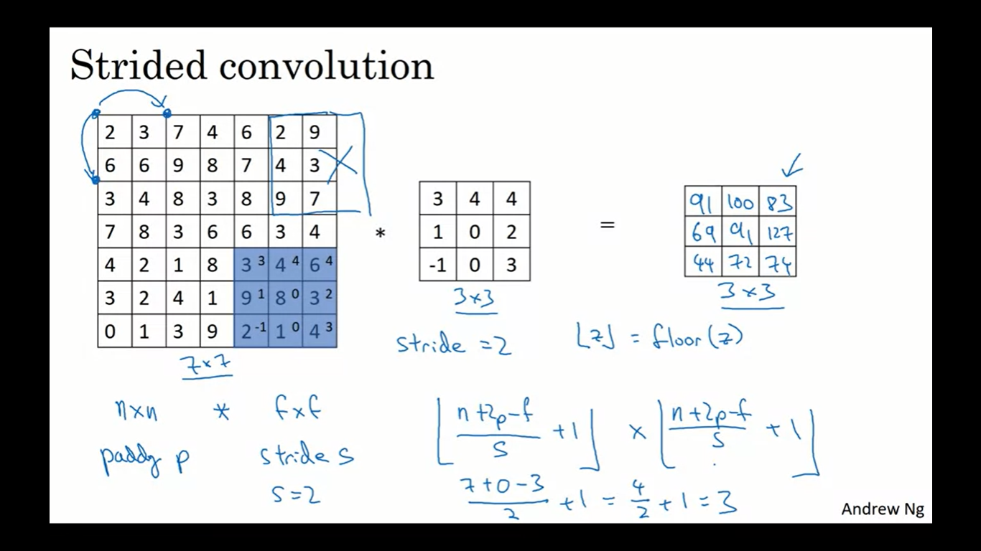

Slide 18
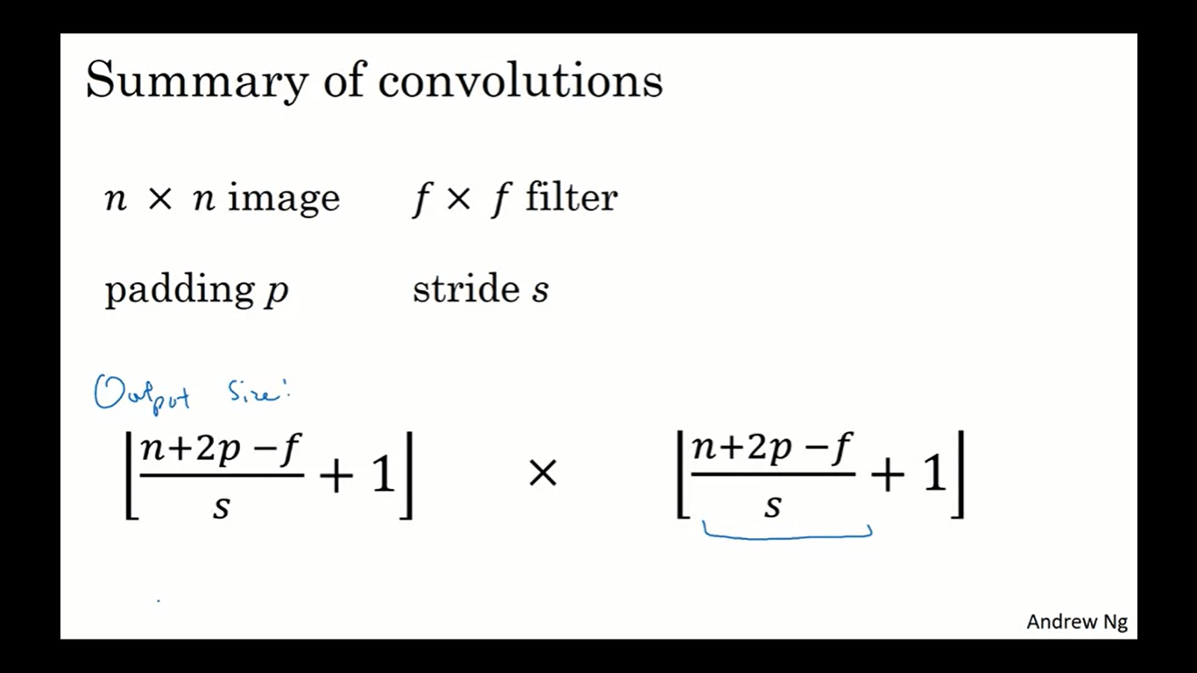

Slide 19
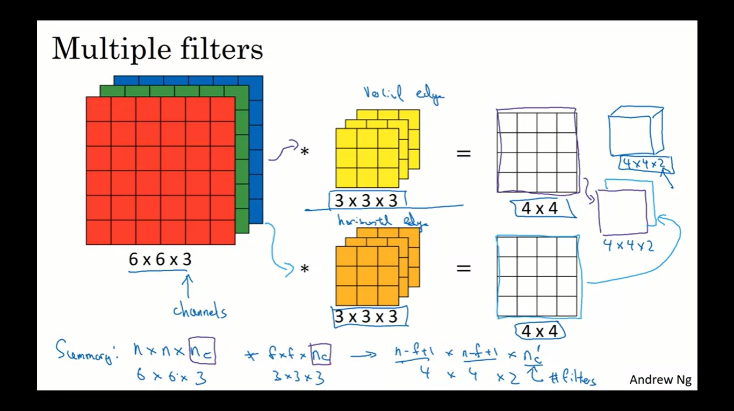

Slide 20
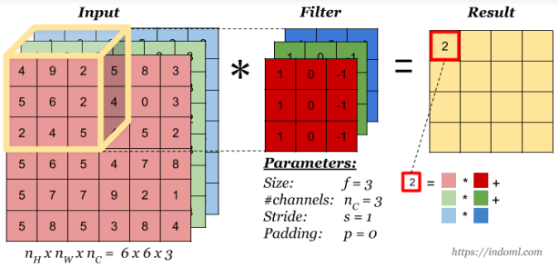
Convolution on RGB images

Slide 21
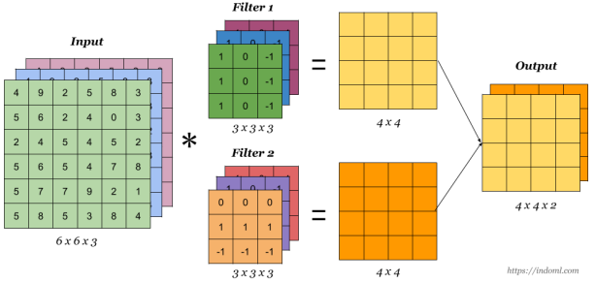
Convolution with multiple filters

Slide 22
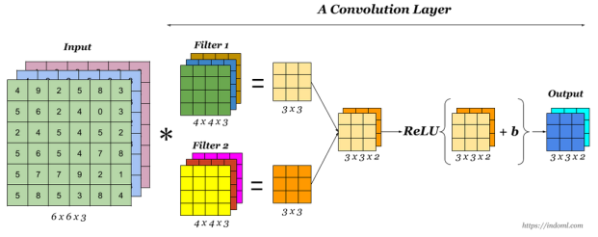
A Convolutional Layer

Slide 23
Limitation of the feature map output of convolutional layers
A limitation of the feature map output of convolutional layers is that they record the precise position of features in the input. This means that small movements in the position of the feature in the input image will result in a different feature map. This can happen with re-cropping, rotation, shifting, and other minor changes to the input image.
A common approach to addressing this problem from signal processing is called down sampling. This is where a lower resolution version of an input signal is created that still contains the large or important structural elements, without the fine detail that may not be as useful to the task.
Down sampling can be achieved with convolutional layers by changing the stride of the convolution across the image. A more robust and common approach is to use a pooling layer.

Slide 24
Pooling
A pooling layer is a new layer added after the convolutional layer. Specifically, after a nonlinearity (e.g. ReLU) has been applied to the feature maps output by a convolutional layer; for example the layers in a model may look as follows:
Input Image - Convolutional Layer - Nonlinearity - Pooling Layer
The pooling operation is specified, rather than learned. (Hence have No learnable parameters). It creates feature maps that summarize the presence of those features in the input. Two common functions used in the pooling operation are:
Maximum Pooling (or Max Pooling): Calculate the maximum value for each patch of the feature map. Average Pooling: Calculate the average value for each patch on the feature map.
The result of using a pooling layer and creating down-sampled or pooled feature maps is a summarized version of the features detected in the input.

Slide 25
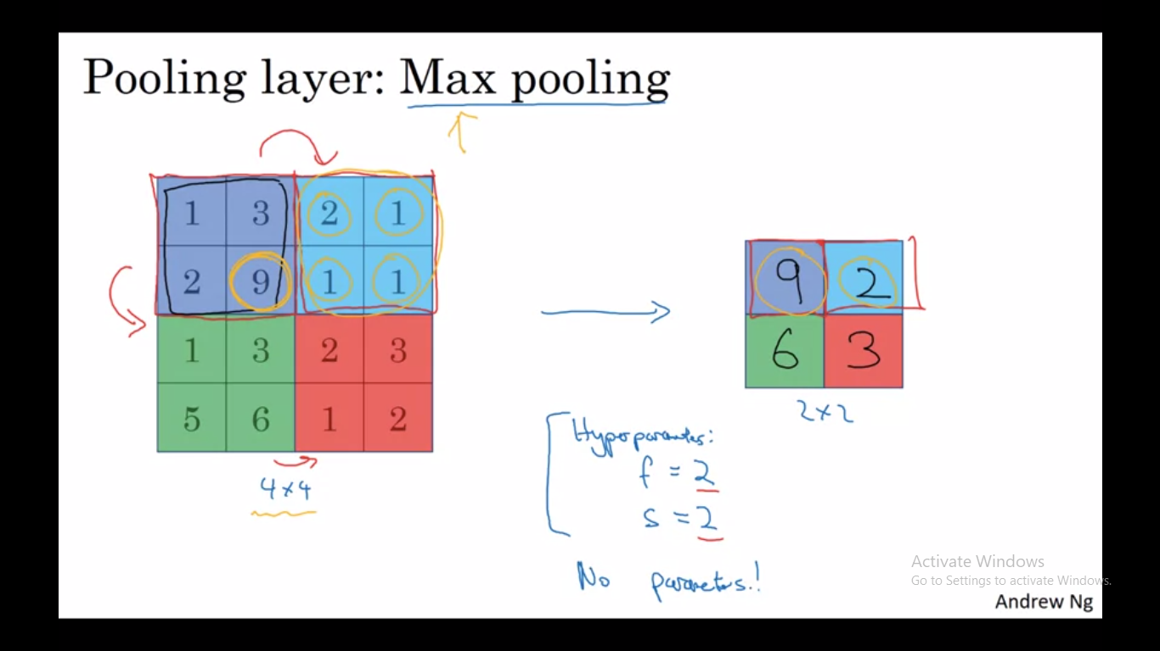

Slide 26
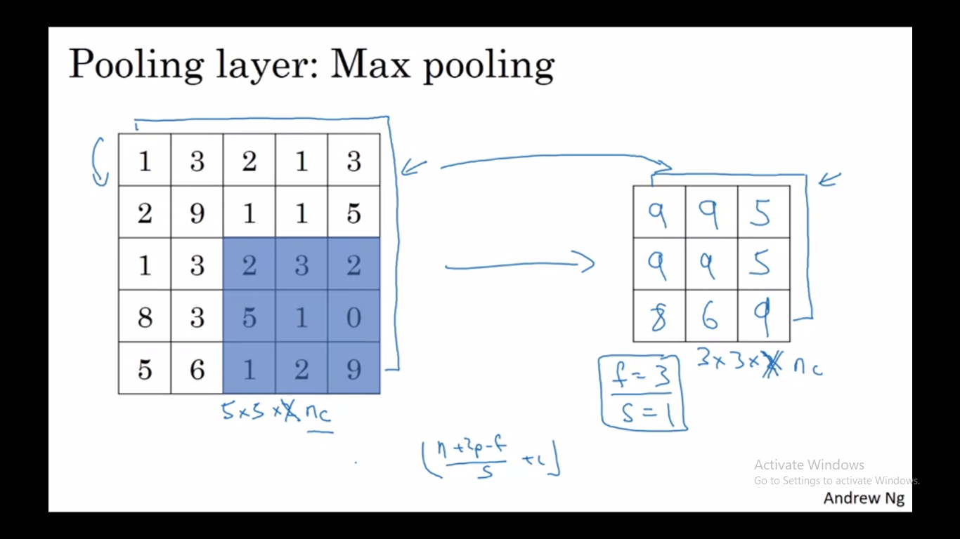

Slide 27
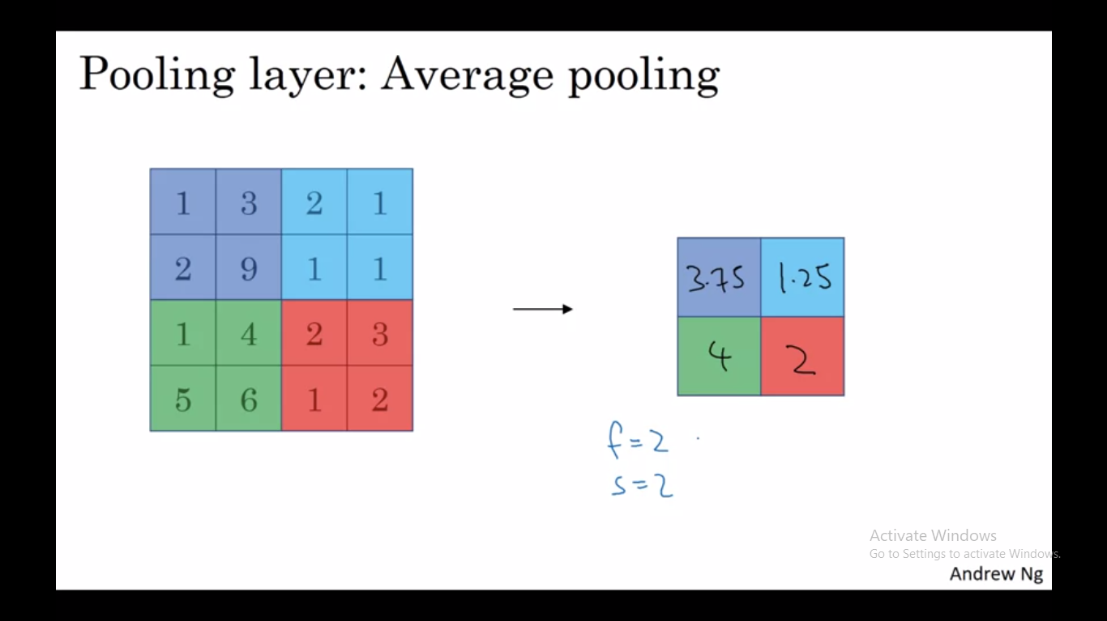

Slide 28
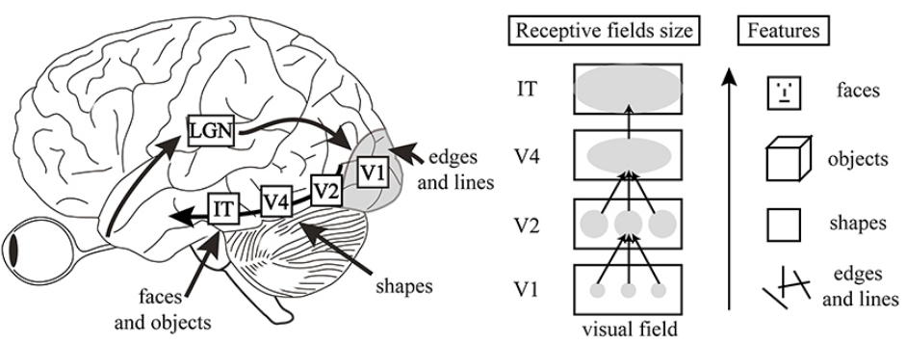
Human Visual Cortex

Slide 29


Slide 30
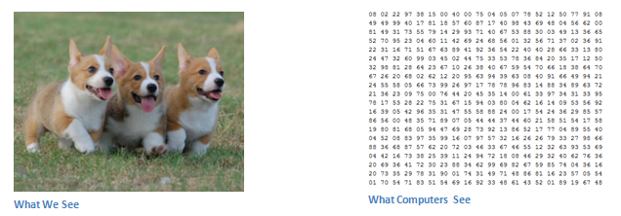
What Human see, What Computer See!

Slide 31
Problems with MLP
Too Many parameters: MLPs (Multilayer Perceptron) use one perceptron for each input (e.g. pixel in an image) and the amount of weights rapidly becomes unmanageable for large images. It includes too many parameters because it is fully connected. Each node is connected to every other node in next and the previous layer, forming a very dense web — resulting in redundancy and inefficiency. As a result, difficulties arise whilst training and overfitting can occur which makes it lose the ability to generalize.
Not translation invariant: MLPs react differently to an input (images) and its shifted version — they are not translation invariant. For example, if a picture of a cat appears in the top left of the image in one picture and the bottom right of another picture, the MLP will try to correct itself and assume that a cat will always appear in this section of the image.
Spatial information: MLPs are not the best idea to use for image processing. One of the main problems is that spatial information is lost when the image is flattened(matrix to vector) into an MLP.

Slide 32
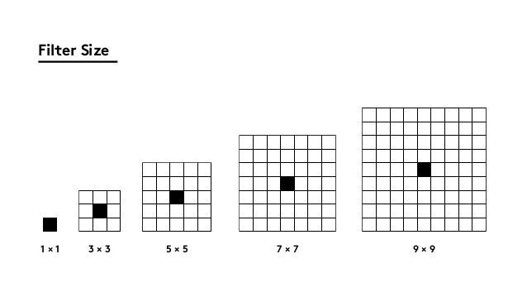

Slide 33


Slide 34
CNN
We can think of a CNN as an artificial neural network that has some kind of specialization for being able to pick out or detect patterns and make sense of them , this pattern detection is what makes CNN so useful for image analysis so if a CNN is just some form of an artificial Neural network, what differentiates it from just a standard multilayer perceptron or MLP.
Well CNN has HIDDEN Layers called CONVOLUTIONAL Layers and these layers are precisely what makes a CNN. CNN’s can and usually do have other Non_Convolutional layers as well but the basis of a CNN is CONVOLUTIONAL layers
Although image analysis has been the most widespread use of CNN’s they can also be used for other data analysis or classification problems as well. More generally, CNNs work well with data that has a spatial relationship. Therefore CNNs are go-to method for any type of prediction problem involving image data as an input.

Slide 35
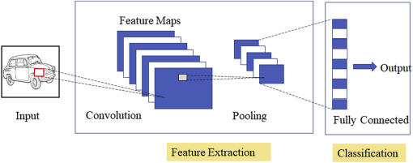
Convolutional Neural Networks have 2 main components.
Feature learning: you can see convolution, ReLU,Pooling layer phases here. Edges,shades,lines,curves, in this Feature learning step are get extracted.
Classification: you see Fully Connected(FC) layer in this phase. They will assign a probability for the object on the image being what the algorithm predicts it is.

Slide 36
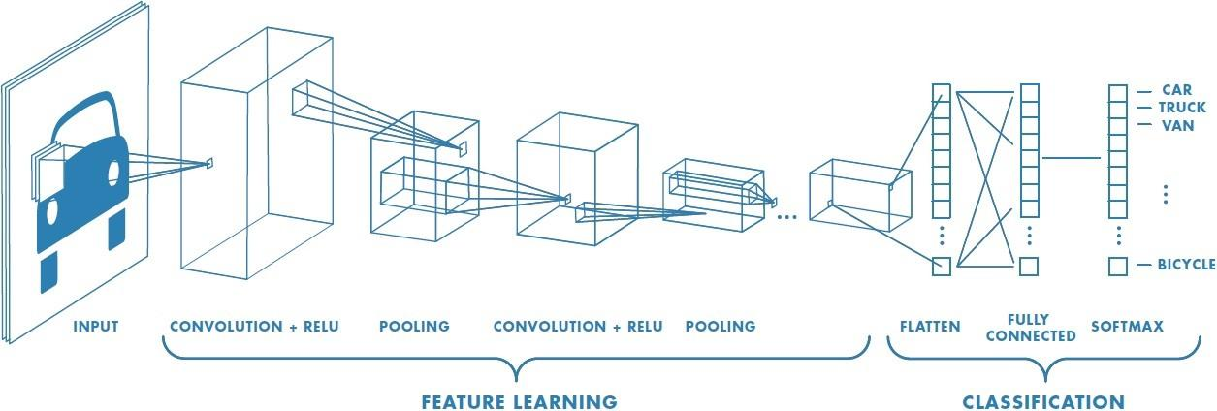
Ideally, CONV + Pooling is termed as a layer.

Slide 37
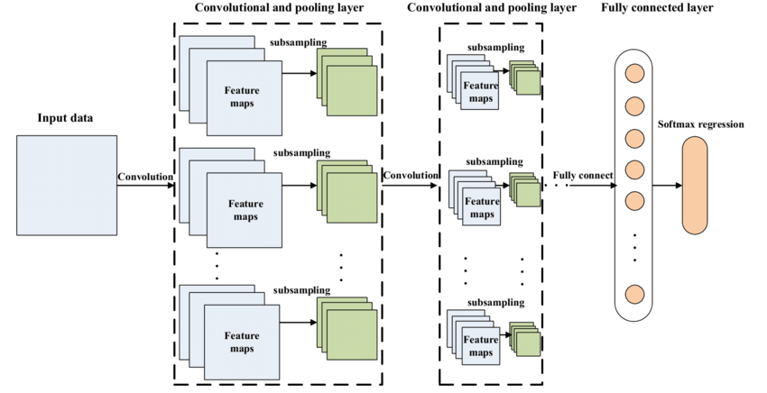

Slide 38
Conv Layer
The result of Convolved feature depends on the three parameters
Summary. To summarize, the Conv Layer:
Accepts a volume of size W1×H1×D1
Requires four hyperparameters:
— Number of filters K,
— their filter size F,
— the stride S,
— the amount of zero padding P.
The first layer of a Convolutional Neural Network is always a Convolutional Layer.
A convolutional neural network consists of an input layer, hidden layers and an output layer.

Slide 39
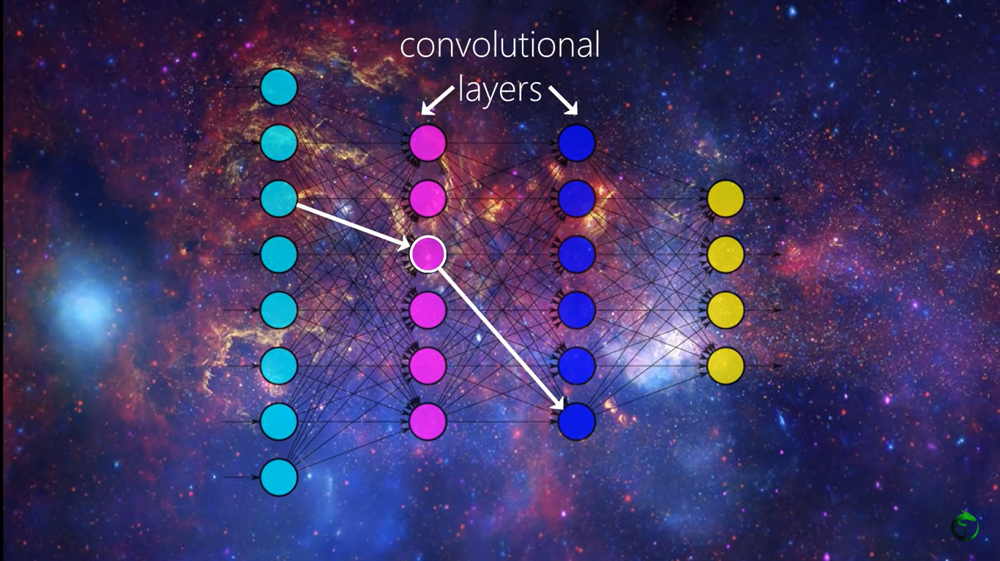
With each convolutional (Hidden) layer we need to specify the number of filters the layers should have.
We also specify the size of filter, and the values within the filter are initialized with random numbers.

Slide 40
A Convolutional Layer

Slide 41

Relu Effect
Left:before relu applied, Right:after ReLU applied

Slide 42
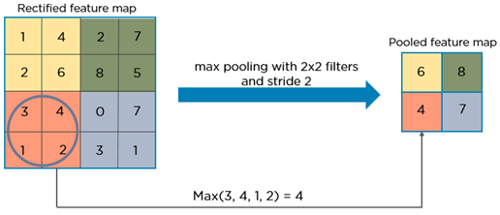
Pooling layer
In this phase the dimensionality of ConvLayer or feature map gets reduced keeping the important information. Have no Learnable parameters.

Slide 44
CNN Applications

Slide 45
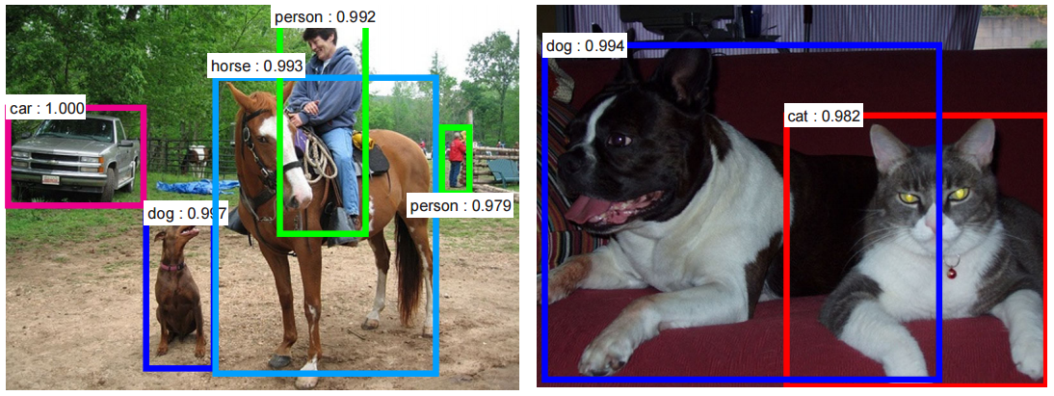
Object Detection

Slide 46
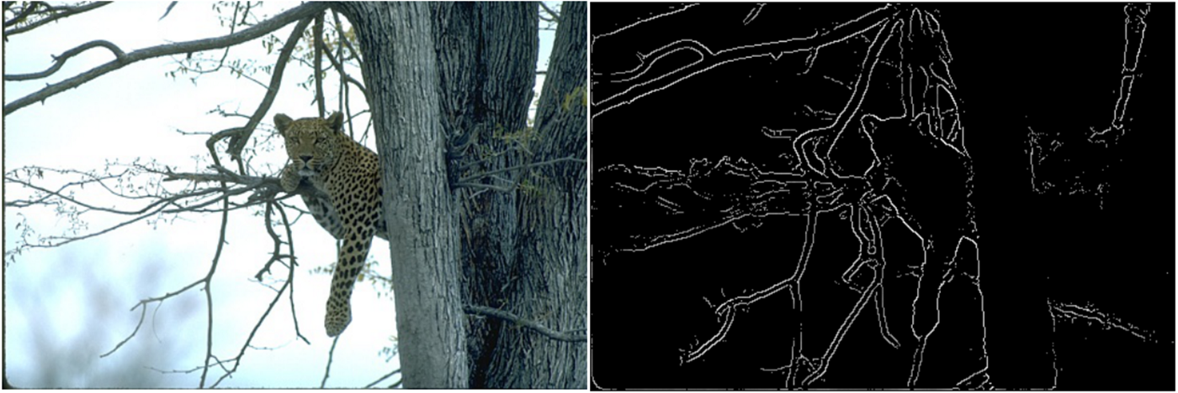
Edge Detection

Slide 47
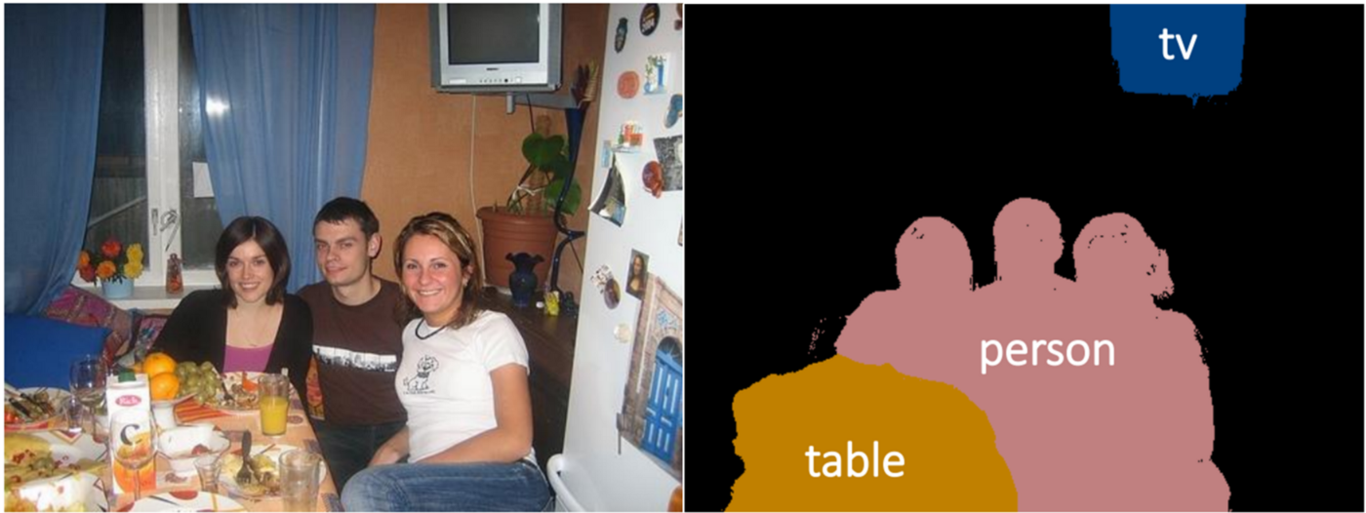
Semantic Segmentation

Slide 48
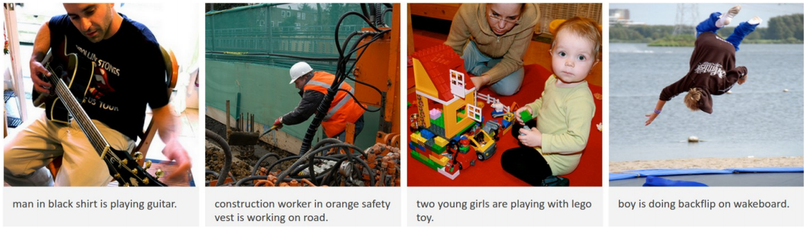
Image Captioning

Slide 49
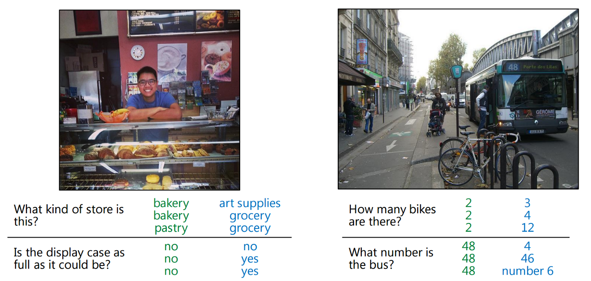
Question & Answering

Slide 50
Object tracking
Video classification
style transfer
And many more.

Slide 51
How CNN Learn - Training

Slide 52
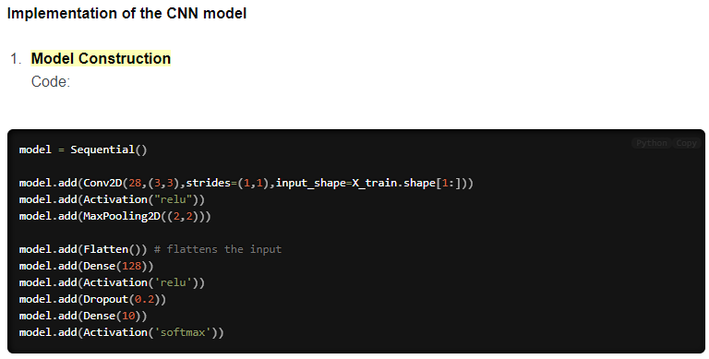

Slide 53
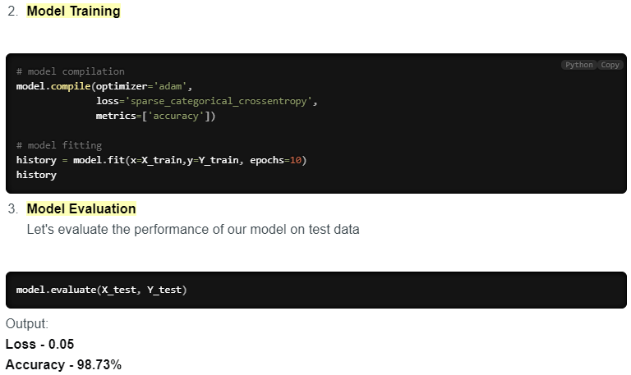

Slide 54
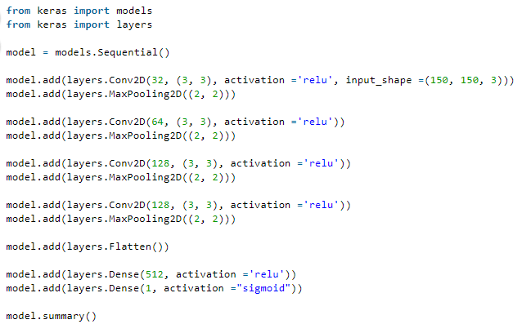
Notice at as our output spatial volume is decreasing our number of filters learned is increasing — this is a common practice in designing CNN architectures

Slide 55
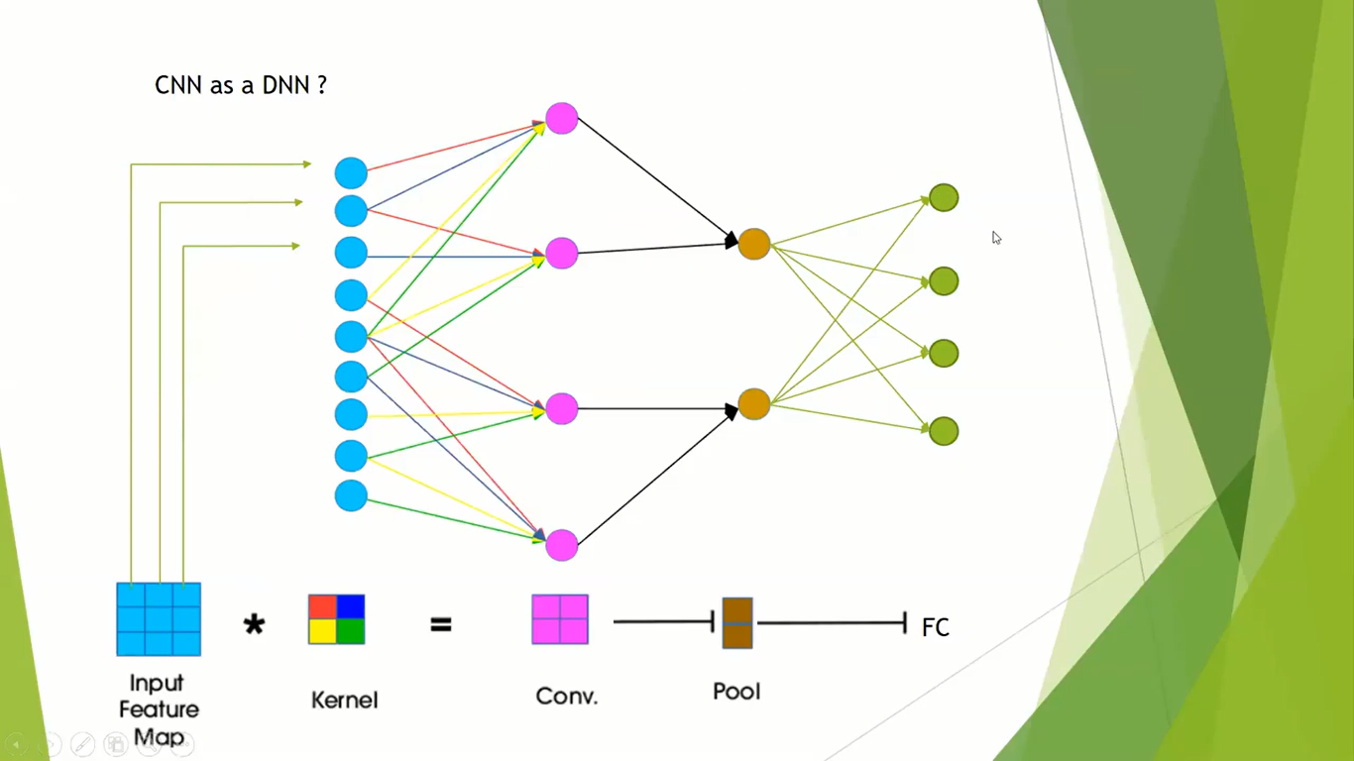
Visualizing CNN as MLP/DNN

Slide 56
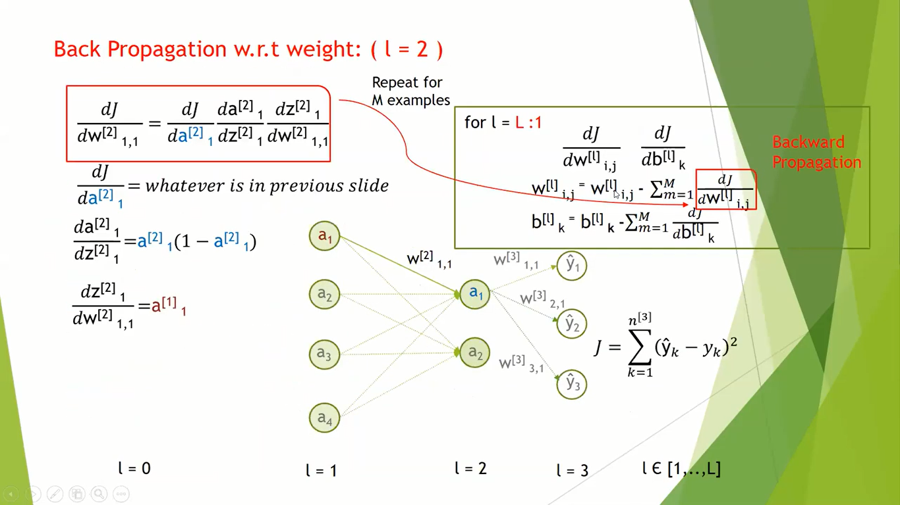

Slide 57
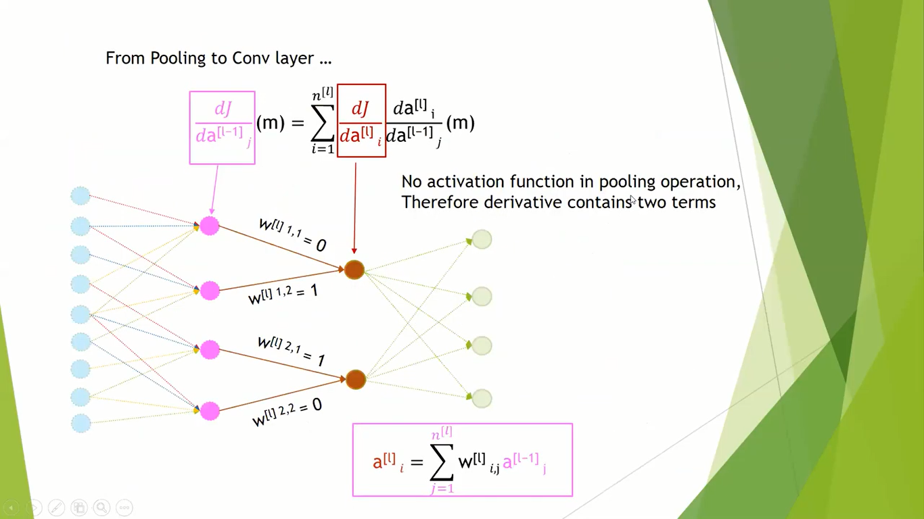

Slide 58
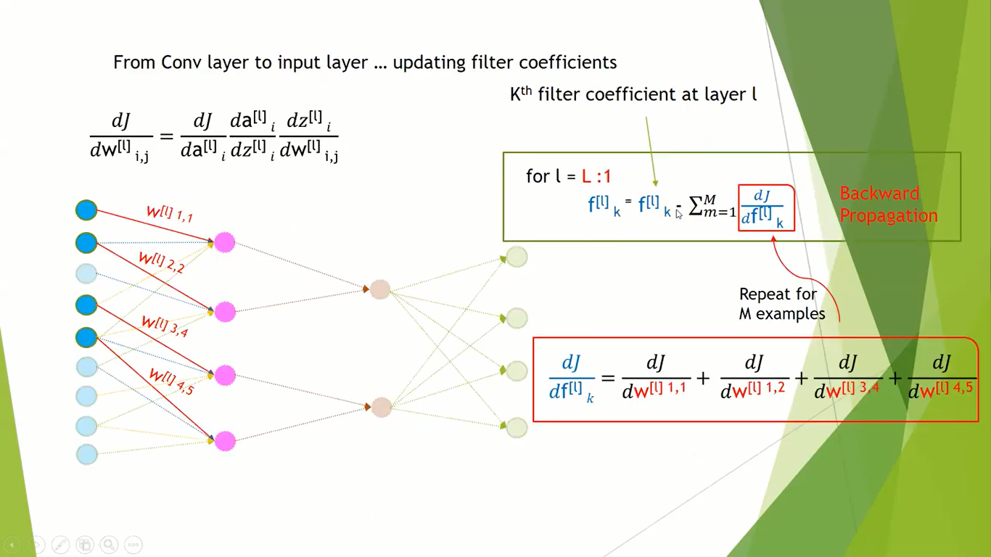

Slide 59
Xtra

Slide 60
How CNN reduce weights? - Weight Sharing
The neural network (in MLP) will learn different interpretations for something that is possibly the same. But in CNN, the number of weights is dependent on the kernel size (see Weight sharing) instead of the input size which is really important for images. So, by forcing the shared weights among spatial dimensions which drastically reduces the number of parameters, the convolution kernel acts as a learning framework.
That’s how convolutional layers reduce memory usage and compute faster.

Slide 61
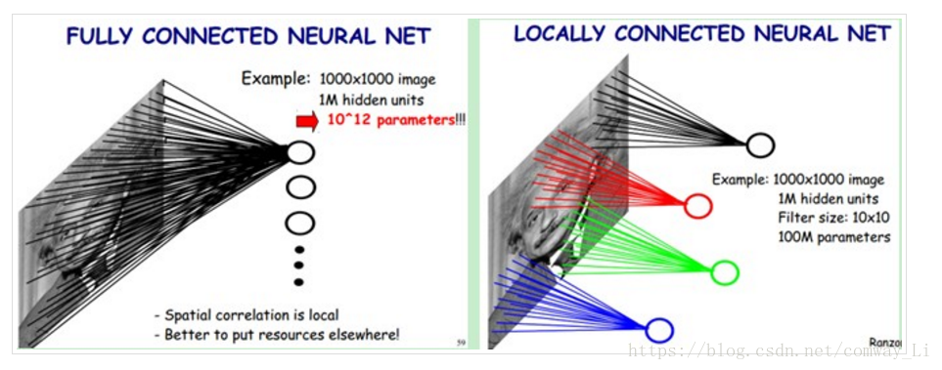
Local connection: the features needed to distinguish different kinds of pictures are only some local areas in the whole picture, so the convolution kernel (receptive field) used in convolution operation can be just a few different small areas, instead of using the convolution kernel (full connection) of the size of the whole picture. This can not only express different features better, but also reduce parameters. For example, in the figure below, on the left is the network using full connection neural network, and on the right is the network using local connection convolution kernel.

Slide 62
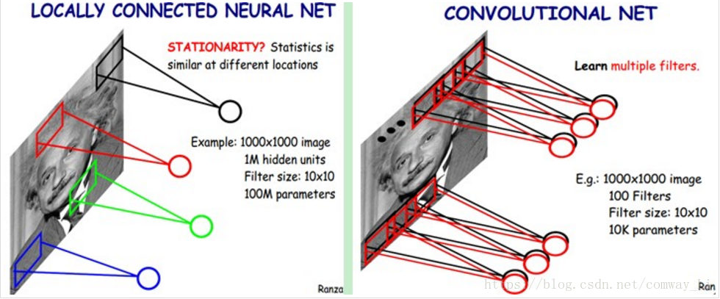
Weight sharing: for a class of pictures, they have similar features, but the position of features in each picture may be shifted. For example, the position of eyes in different face photos may change, and rarely two photos have the same eye position. When a picture is convoluted, there can be multiple convolution kernels to extract different features, but the weight of a convolution kernel remains unchanged in the process of moving (of course, the weight of different convolution kernels is not shared). This can not only ensure that the feature extraction is not affected by the location, but also reduce the number of parameters.

Slide 63
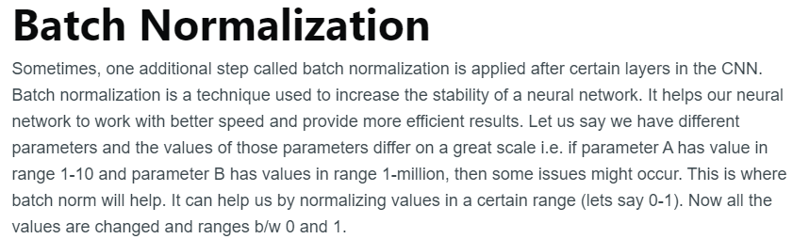

Slide 64
Important Links
https://iq.opengenus.org/understanding-convolutional-neural-networks-through-image-classification/
https://iq.opengenus.org/operations-in-cnn/
https://adeshpande3.github.io/A-Beginner%27s-Guide-To-Understanding-Convolutional-Neural-Networks/
cs231n.github.io/convolutional-networks/
https://towardsdatascience.com/cnn-architectures-a-deep-dive-a99441d18049
https://programmer.help/blogs/5edca38d058b0.html
*https://towardsdatascience.com/derivation-of-convolutional-neural-network-from-fully-connected-network-step-by-step-b42ebafa5275
https://programmer.help/blogs/5edca38d058b0.html

Slide 65
https://slideplayer.com/slide/14119248/
https://www.pyimagesearch.com/2021/05/14/convolutional-neural-networks-cnns-and-layer-types/
https://www.jefkine.com/general/2016/09/05/backpropagation-in-convolutional-neural-networks/
https://stats.stackexchange.com/questions/159588/how-does-local-connection-implied-in-the-cnn-algorithm
https://pennlio.wordpress.com/2014/04/11/fully-connected-locally-connected-and-shared-weights-layer-in-neural-networks/
https://medium.com/technologymadeeasy/the-best-explanation-of-convolutional-neural-networks-on-the-internet-fbb8b1ad5df8
http://www.wildml.com/2015/11/understanding-convolutional-neural-networks-for-nlp/
https://polakowo.io/datadocs/docs/deep-learning/cnns
https://freecontent.manning.com/deep-learning-for-image-like-data/

